Slide 1
Face Age Editing with Fine-Tuned Diffusion Models: A Comparative Study
Juncheng Long: Math & Statistics & Data Science (Senior)
Dinh Quoc Vuong: Data Science (Junior)
Ian Franda: Statistics, Computer Science, and Math (Senior) Shashwat Negi: Data Science (Graduate Student)

Slide 2
Introduction
Main Goal:
Predicting what people looks like at a target age
Comparative study of different methods of fine-tuning
Main Reason:
Interested in what we looks like when we get older
Find out which method of fine-tuning is less computationally costly
Study how realistic the image generated by models is under a computational constraints

Slide 3
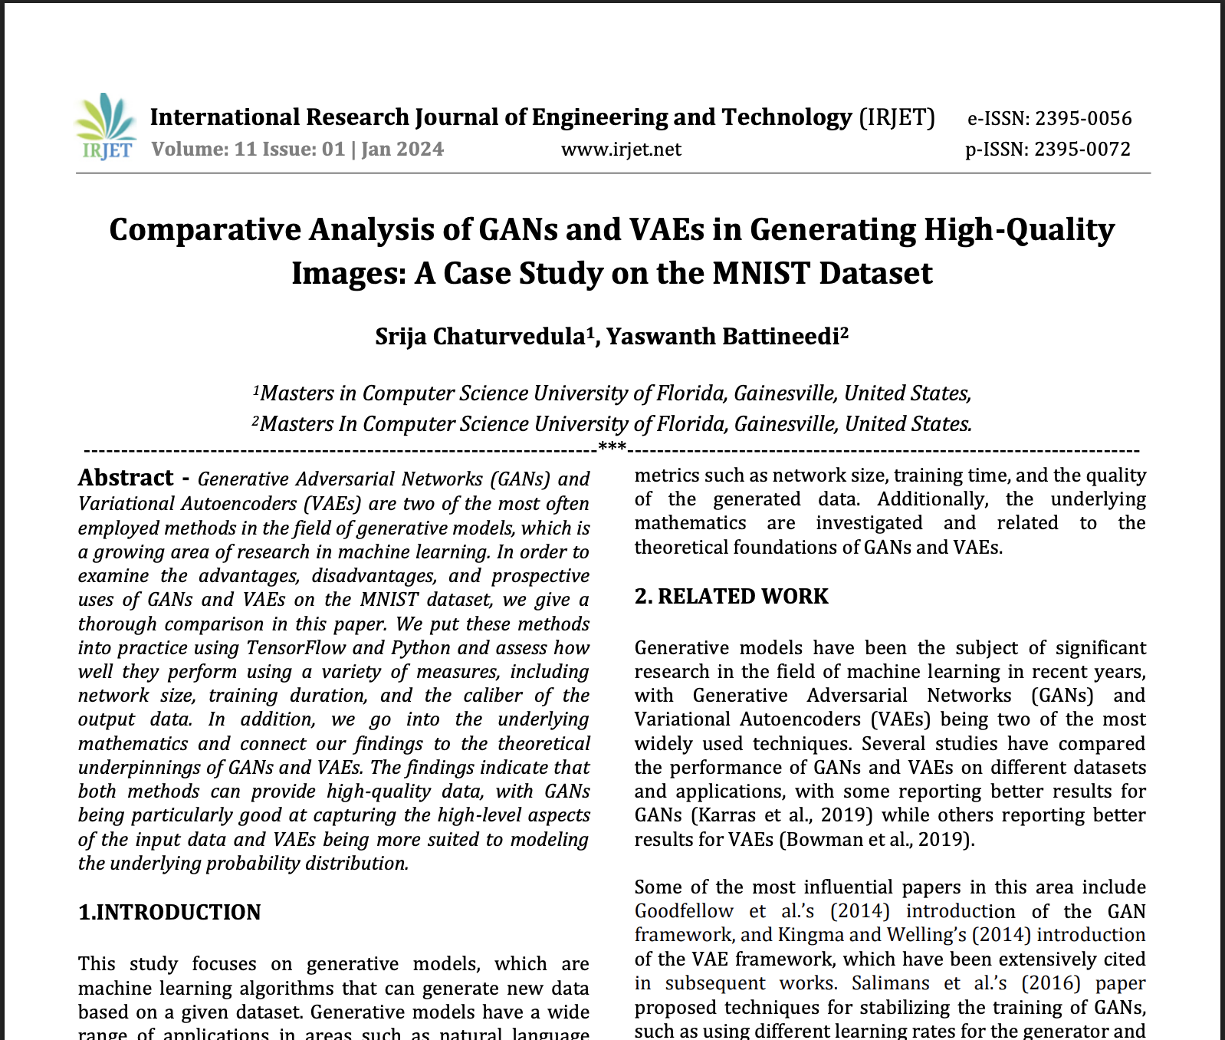
The problem with traditional image generation (TIG)
Literature Review (1)
Generative Adversarial Networks (GANs)
Training instability
Mode collapse
Hard to tune
Variational Autoencoders (VAE)
Blurry Outputs
High reconstruction error
Underfitting Complex Distributions
Notes:
One of the papers we looked at compares GANs and VAEs on the MNIST dataset.
Before diffusion models, these were the go-to approaches for image generation — but both had major tradeoffs.
GANs can generate sharp images, but they’re unstable to train. They often suffer from mode collapse, producing repetitive outputs, and lack a clear latent space, making editing hard.
VAEs are more stable and interpretable, but their outputs are often blurry. In the paper, they scored worse in visual quality — a FID of 28.56 vs. 18.24 for GANs. They also struggle to model complex distributions due to their Gaussian latent space.
In short: GANs give realism without control, VAEs give structure without detail — and both fall short of what diffusion models can do

Slide 4
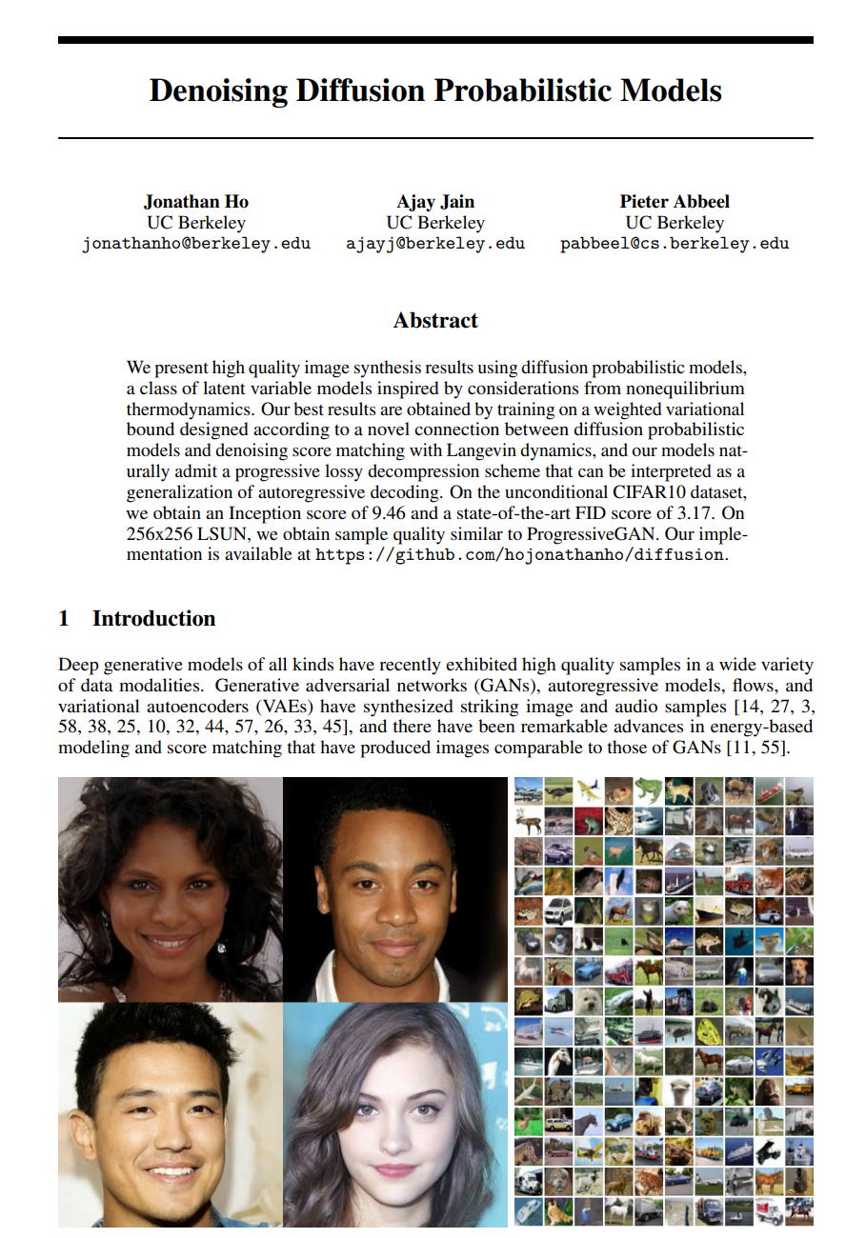
Diffusion Models - A better approach
Literature Review (2)
Question is: What are diffusion models? And how it differs from the two previous models?
Learn to reverse noise
Stable training
High-quality, diverse outputs
Flexible conditioning
Still quite slow and resource-intensive
Notes:
Next, we looked at the paper Denoising Diffusion Probabilistic Models.
Unlike GANs or VAEs, which generate images in a single step, diffusion models start with noise and denoise gradually, step by step, to form an image. It’s a physics-inspired process — the model learns to reverse added noise, making training stable and reliable.
They avoid adversarial training, produce more photorealistic and diverse images, and are modular — they can take in text, sketches, or other images as input.
But early diffusion models were slow, since they worked in pixel space. That led to the innovation of latent diffusion, which is what powers Stable Diffusion — the core engine behind the two models we’ll explore next.

Slide 5
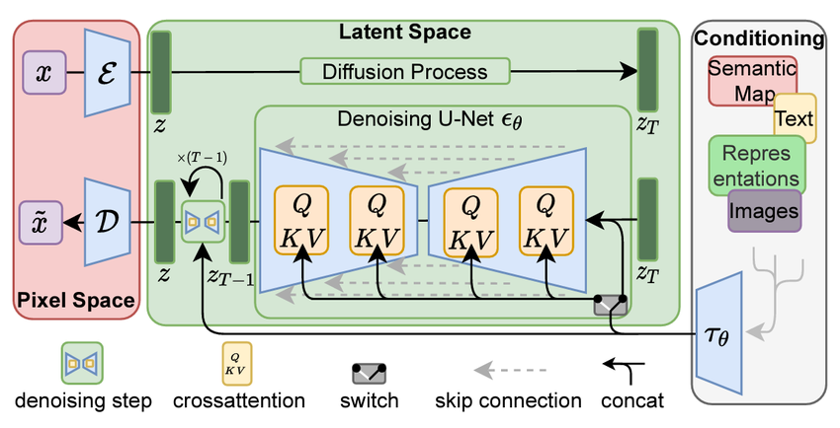
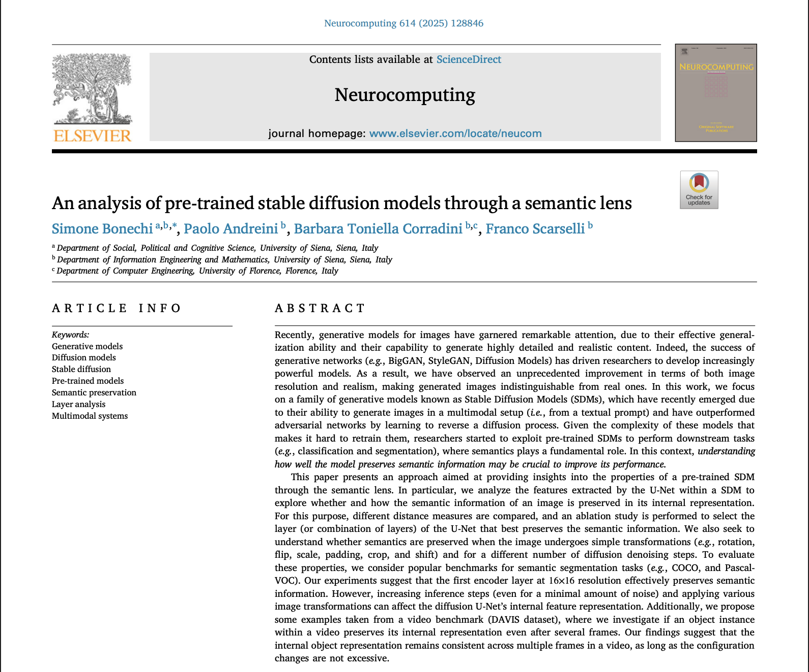
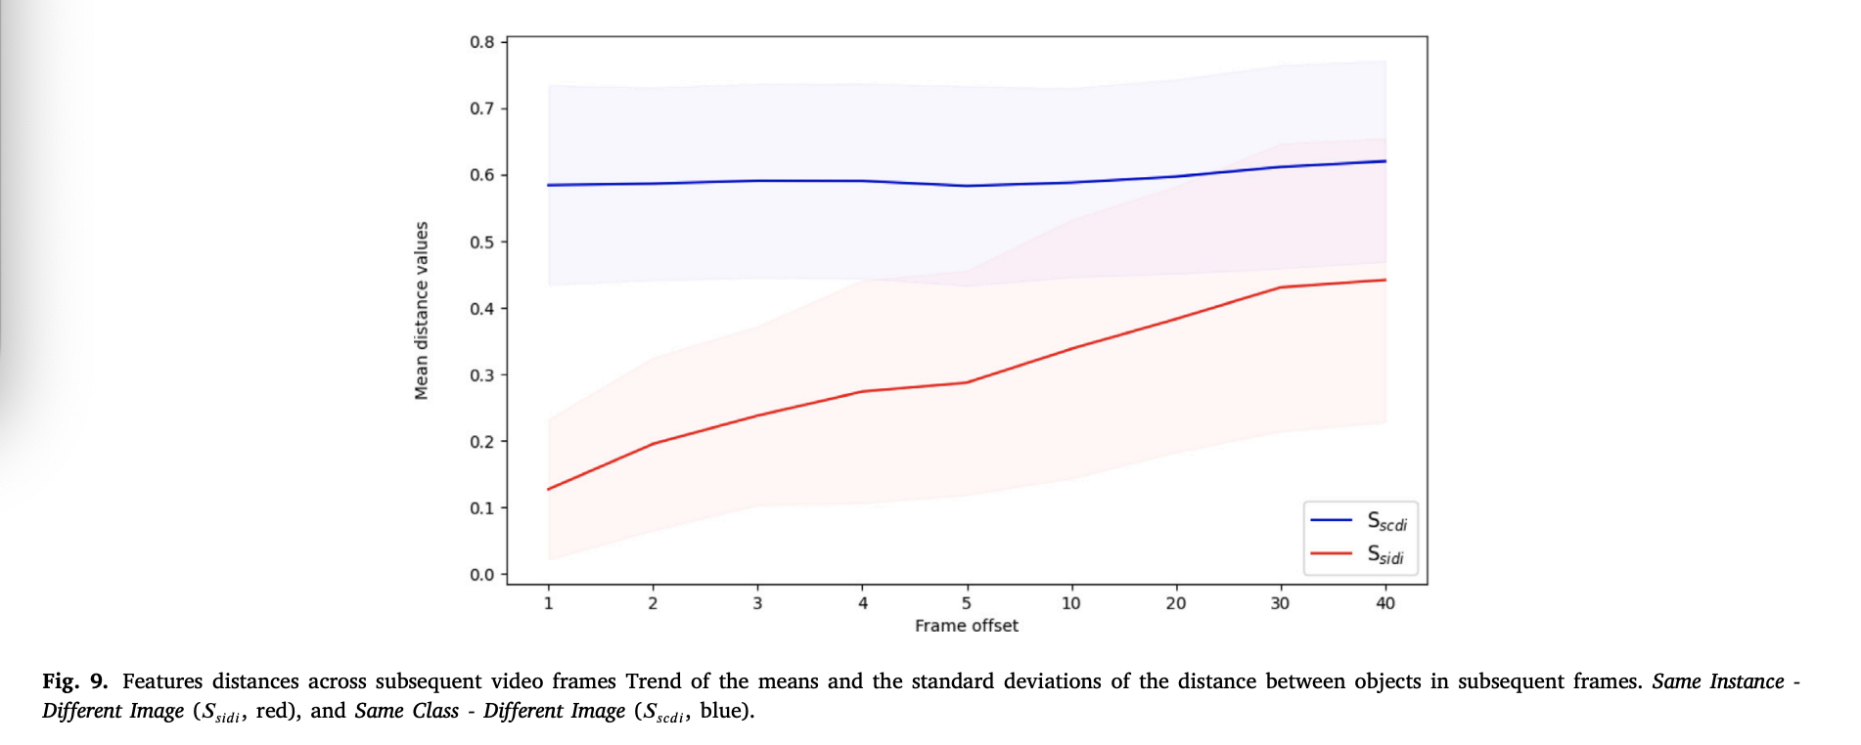
Literature Review (3)
Blue line stays flat → SDMs hold stable feature embeddings for same-class objects
Red Line diverge indicates semantic sensitivity, not collapse.
Notes:
We start in pixel space, where the image is high-dimensional — typically 512×512 with 3 channels. Instead of working directly here, we use a VAE encoder (𝓔) to compress it into latent space, capturing structure and layout while discarding pixel-level detail. This makes denoising much faster (1), allows the model to focus on meaningful features (2), and quality is restored at the end via decoding (3).
Latent space is a smaller, abstract representation — usually 64×64×4 — where the model “thinks.” It’s efficient, saving computation and memory by modeling only what matters. This is where the denoising process takes place
The denoising process adds noise step by step, then trains the model to reverse it. It’s inspired by how images degrade and is likelihood-based, meaning we can assign probabilities and optimize generation with mathematical rigor.
The core model is a U-Net, with encoder–decoder paths and skip connections. This U-shaped design balances global context and fine detail, preserving structure throughout denoising ing process. That’s why it is really good at image segmenting
Cross-attention layers (Q-K-V) inject external input — like a text prompt — into the generation. They align concepts (like “dog on a mountain”) with spatial positions in the image, enabling precise, controlled outputs. Simply it tells the model the position on the image
Stable Diffusion is modular: it works with text, images, masks, and more. It’s not just text-to-image — it supports tasks like image-to-image and inpainting.
Finally, a decoder (𝓓) turns the denoised latent back into a full-resolution image — the one we actually see.
Now look at Figure 9. It tracks how image features behave across frames in a video. Blue shows same-class but different images. Red shows different instances. You’ll notice the blue line stays flat — meaning SDMs hold onto their understanding of the object even as it changes slightly — a sign of semantic stability.
This is a key observation because SDMs can be used for tasks like classification, segmentation, or even video tracking since it can understand and preserve meanings.

Slide 6
Literature Review(4)
Limitations of Early Diffusion Models
Early Diffusion Models (Denoising Diffusion Probabilistic Model)
Denoise in pixel space → high accuracy but extremely slow and computationally costly
Unconditional diffusion → no CLIP
Long-time diffusion → hundreds to thousands of steps
Stable Diffusion Model
Compresses images into latent space → faster sampling due to extremely lower dimensionality
Conditioning using CLIP → allows multi-modality
Invariant to masking, occlusion, rotation because semantic structure is still preserved.
Notes:
Early diffusion models like DDPMs worked in pixel space, denoising each pixel step-by-step — making them slow and hard to scale. They also lacked mechanisms to follow text instructions, since they couldn’t connect meaning to images.
Stable Diffusion solved both issues by operating in latent space, which is faster and still captures image structure. It also integrates CLIP, which standards for Contrastive Language-Image Pre-training, allowing precise control via text prompts.
In the paper we reviewed, even with masking or rotation, Stable Diffusion retained semantic coherence, showing strong robustness and interpretability — a key advantage over earlier models.

Slide 7
Literature Review (5) -
Ruiz, Nataniel, et al. "Dreambooth: Fine tuning text-to-image diffusion models for subject-driven generation."
Goal: fine-tune a pretrained text-to-image model with only a few sample images
Use a unique identifier to embed training data’s information into the model
This is “Dreambooth”
Chen, Xiangyi, and Stéphane Lathuilière. "Face aging via diffusion-based editing."
Goal: novel approach to face-aging editing using a generalized latent diffusion model
Employs two step process:
Fine-tuning pre-trained LDM for age-aware face generation
Inference on real input using inversion and text-guided local age editing via cross attention
Notes:
While diffusion models were an exciting new direction after GANs, their first versions — like DDPMs — had major bottlenecks.
These models operated directly in pixel space, meaning they had to denoise every single pixel step-by-step. That made them very slow, especially at high resolutions. They also weren’t designed to take instructions like “draw a red dragon wearing sunglasses.” because they do not methods like CLIP to “inject” meaning to image.
That’s where Stable Diffusion changed everything. It introduced the idea of running the diffusion process not in pixel space, but in latent space — a compressed version of the image that still retains semantic structure.
This change alone slashed the computation cost by orders of magnitude, while still allowing for photorealistic output. But more than that, it made it easy to inject external control, like a text prompt from CLIP.
In the paper we reviewed, the authors show that even after masking parts of an image or rotating it, Stable Diffusion models still retain semantic coherence. For example, an image partially masked still produces a denoised latent that’s semantically aligned with the original — a big win for robustness and interpretability.

Slide 8
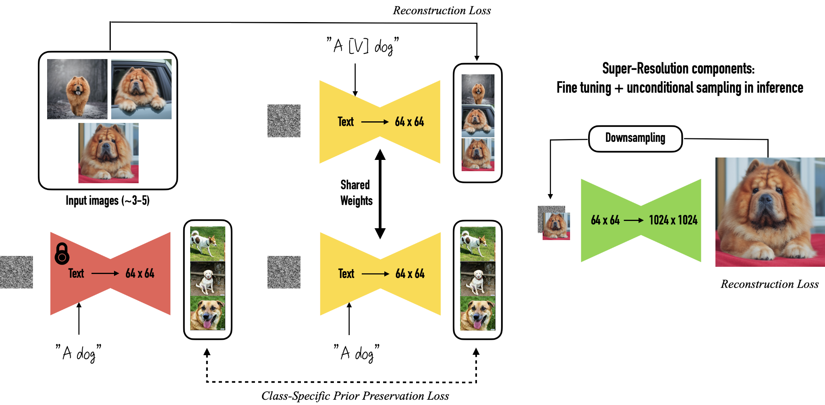
Overview of methods
Idea: Stable diffusion modes can not be fine tuned for realistic face age editing because
Costly: with ~850M parameters, SDM’s are resource-intensive and time-consuming
Risky: can lose general image generation ability called catastrophic forgetting
Lightweight methods tailored for realistic and identity-preserving face are more ideal like:
DreamBooth: a few-shot learning technique that fine-tunes select components of the U-Net in Stable Diffusion.
Image Inversion + Cross-Attention: maps a real image to the model’s latent noise space. Leverages cross-attention to focus on age-relevant facial regions during generation, ensuring realistic and identity-preserving edits.

Slide 9


Key implementation (Dreambooth)
Goal: “teach” the stable diffusion the meaning of a new word
Model Implementation Details:
Total params: 859,520,964
~5 billion image/text pairs
Resources for fine-tuning:
Hugging face: Diffusers, Accelerate
ShivamShrirao diffuser extensions
Google Colab T4
(Training and generation time is ~15 minutes total)

Slide 10
Key implementation (Dreambooth)
Goal: “teach” the stable diffusion the meaning of a new word
Class Tokens
Rare Tokens
Stable diffusion is built on “tokens”
Rare tokens are tokens with little meaning
We can train the model to associate a rare token with something
Dog
Cat
Person
skw
zwx
xxy5syt

Slide 11

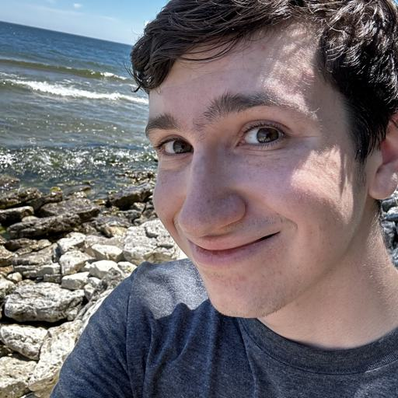

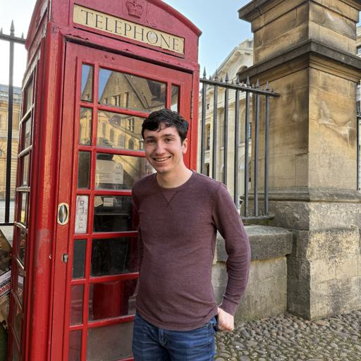

Key implementation (Dreambooth)
Goal: “teach” the stable diffusion the meaning of a new word
Class Tokens
Rare Tokens
Fine-tune stable diffusion to learn that “skw” is a “person” that looks like these training images:
Dog
Cat
Person
skw
zwx
xxy5syt
(Input images are 512x512)

Slide 12
Key implementation (Dreambooth)
Goal: “teach” the stable diffusion the meaning of a new word
Challenges:
Learn what “skw” looks like in reasonable time
Don’t forget what a generic “Person” looks like (Catastrophic Forgetting)
Don’t overtrain so that it just recreates training images
Class Tokens
Rare Tokens
Dog
Cat
Person
skw
zwx
xxy5syt
Choose combination of:
Learning rate = 1e-5
Training steps = 400
Class images generated = 10

Slide 13
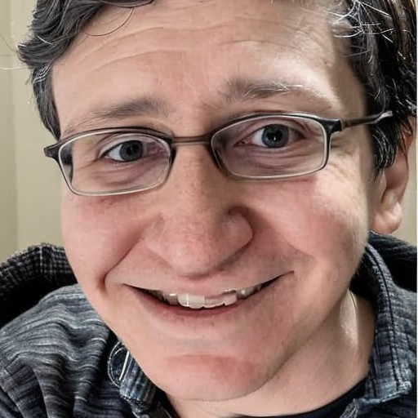
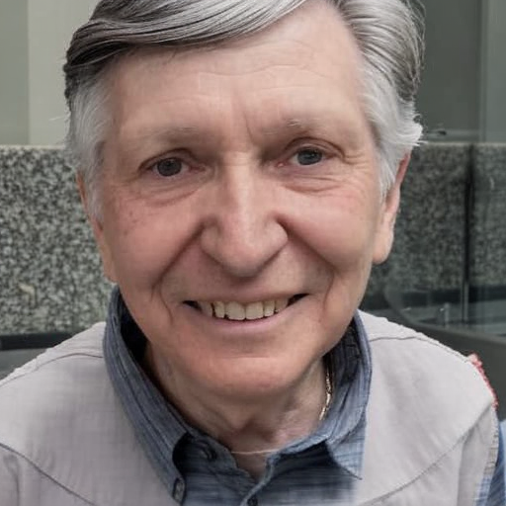
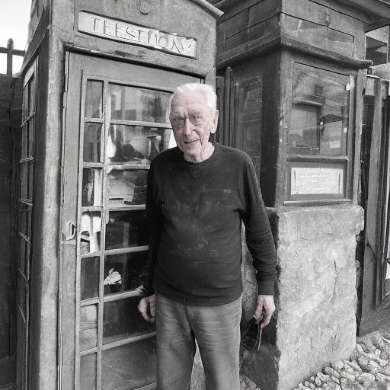
Key results (DreamBooth)
“Photo of sks person at 50 years old”
“Photo of sks person at 80 years old”
Training Images
Some evidence of overfitting
(No evidence of catastrophic forgetting found)

Slide 14

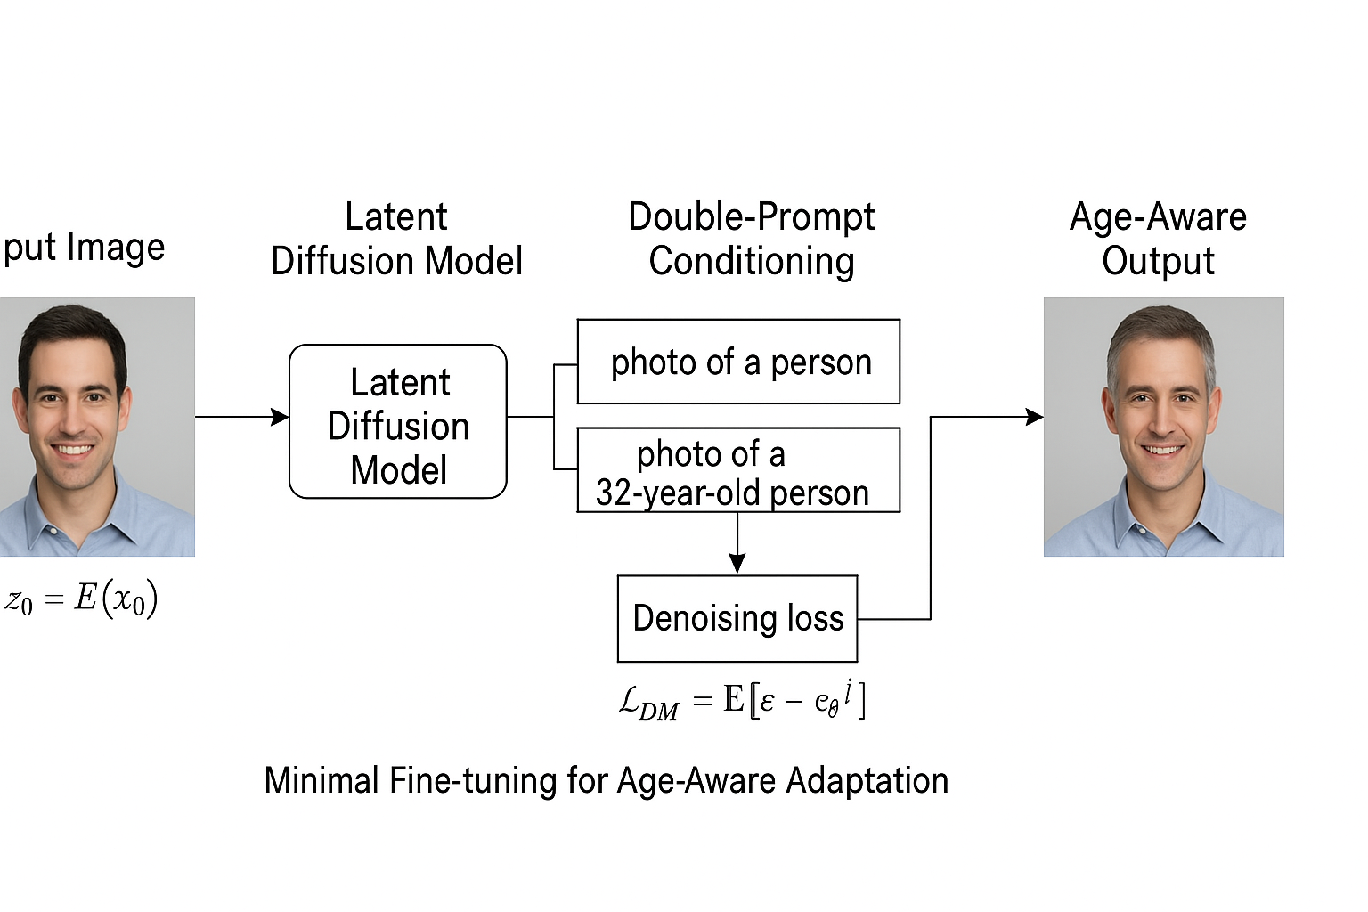
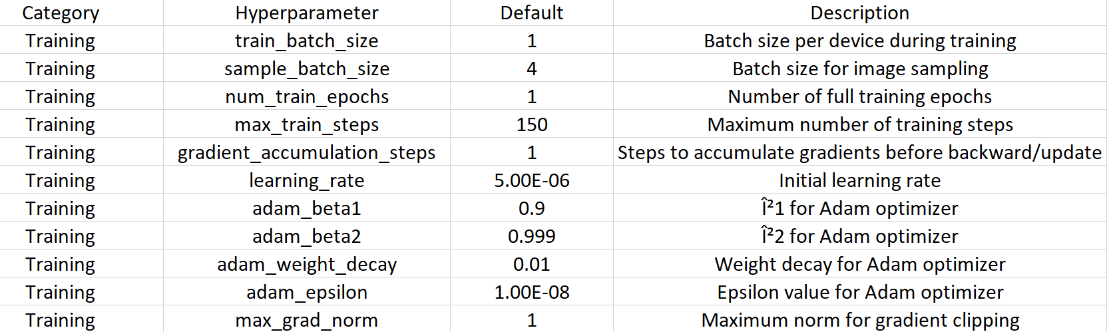
Key Implementation (Inversion and Cross Attention)
2-Step Lightweight Task-Specific Adaptation: Specialization and Editing
Specialization: minimal and targeted fine-tuning of general-purpose latent diffusion model to generate specialized age aware faces. We performed age-aware specialization on the Stable Diffusion model from the Hugging Face Diffusers library using a sample from the FFHQ-Aging dataset.
Image → [Auto-Encoder] → Latent Space + Noise → [Denoising Model] → Clean Latent → Text Embedding ("young", "old") → [Fine-Tuning] → Age-Specific Image Output
The FFHQ-Aging dataset contains approximately 70,000 high-resolution (1024×1024) RGB face images with their age group information. This dataset is used for identity-preserving facial aging tasks.
Hyperparameters used in adaptive fine-tuning of the Stable Diffusion model include: Learning Rate(5e-6), Adam_optimizer Beta1& Beta2
Notes:
Anther method we employ to adapta a latent diffusion model like stable discuss was using a 2 step process in which 1 step was to Finetune the SDM to be able to generate face images conditioned on a age-related text prompt

Slide 15

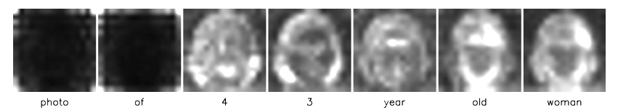
Key Implementation (Inversion and Cross Attention)
We provide a specific input face image on which image inversion, null-text optimization, and text-guided age editing via cross-attention are performed for original identity preservation and age editing.
Image Inversion and Null-Text Optimization: To edit a specific input image, the model inverted image into the latent noise space of the diffusion model. Concurrently, it optimizes the null-text embeddings to better reconstruct the original image. This inversion technique provides precise control over the editing process.
Text-Guided Local Age Editing via Attention Control: Cross attention maps are used to guide the diffusion process with textual prompts specifying the target age. This allows for localized editing of age-related features (such as wrinkles or skin texture) without altering other facial attributes, ensuring the edited image preserves the original identity.

Slide 16
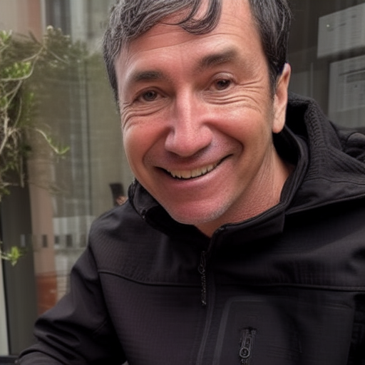
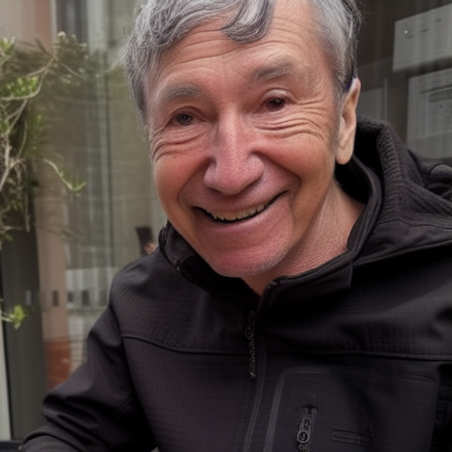
Key Results ( Inversion and Cross Attention)
Inference Input Image
“Photo of a 50 years old man”
“Photo of a 80 years old man”
Input Prompt: ‘A photo of a {age} year old person’
Input Prompt 2: ‘Photo of a {target age} year old {man/women}’
*Manual inspection reveals that the Inversion and Cross-Attention technique outperforms DreamBooth for the same input image. (currently working on both qualitative and quantitative metrics)

Slide 17
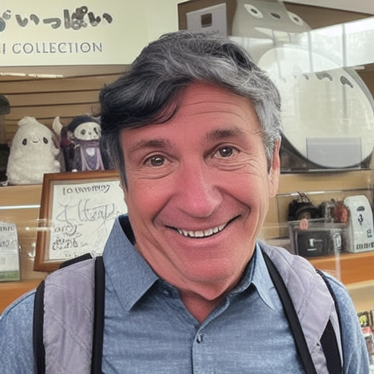
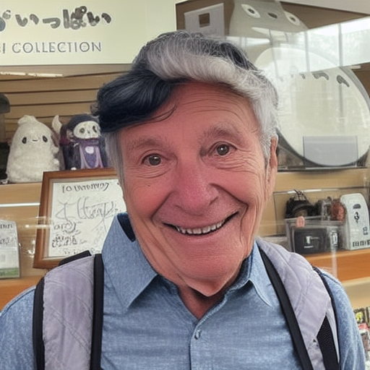
Key Results (Image Inversion)
Inference Input Image
“Photo of a 50 years old man”
“Photo of a 80 years old man”
Input Prompt: ‘A photo of a {age} year old person’
Input Prompt 2: ‘Photo of a {target age} year old {man/women}’
*Manual inspection reveals that the Inversion and Cross-Attention technique outperforms DreamBooth for the same input image. (currently working on both qualitative and quantitative metrics)

Slide 18
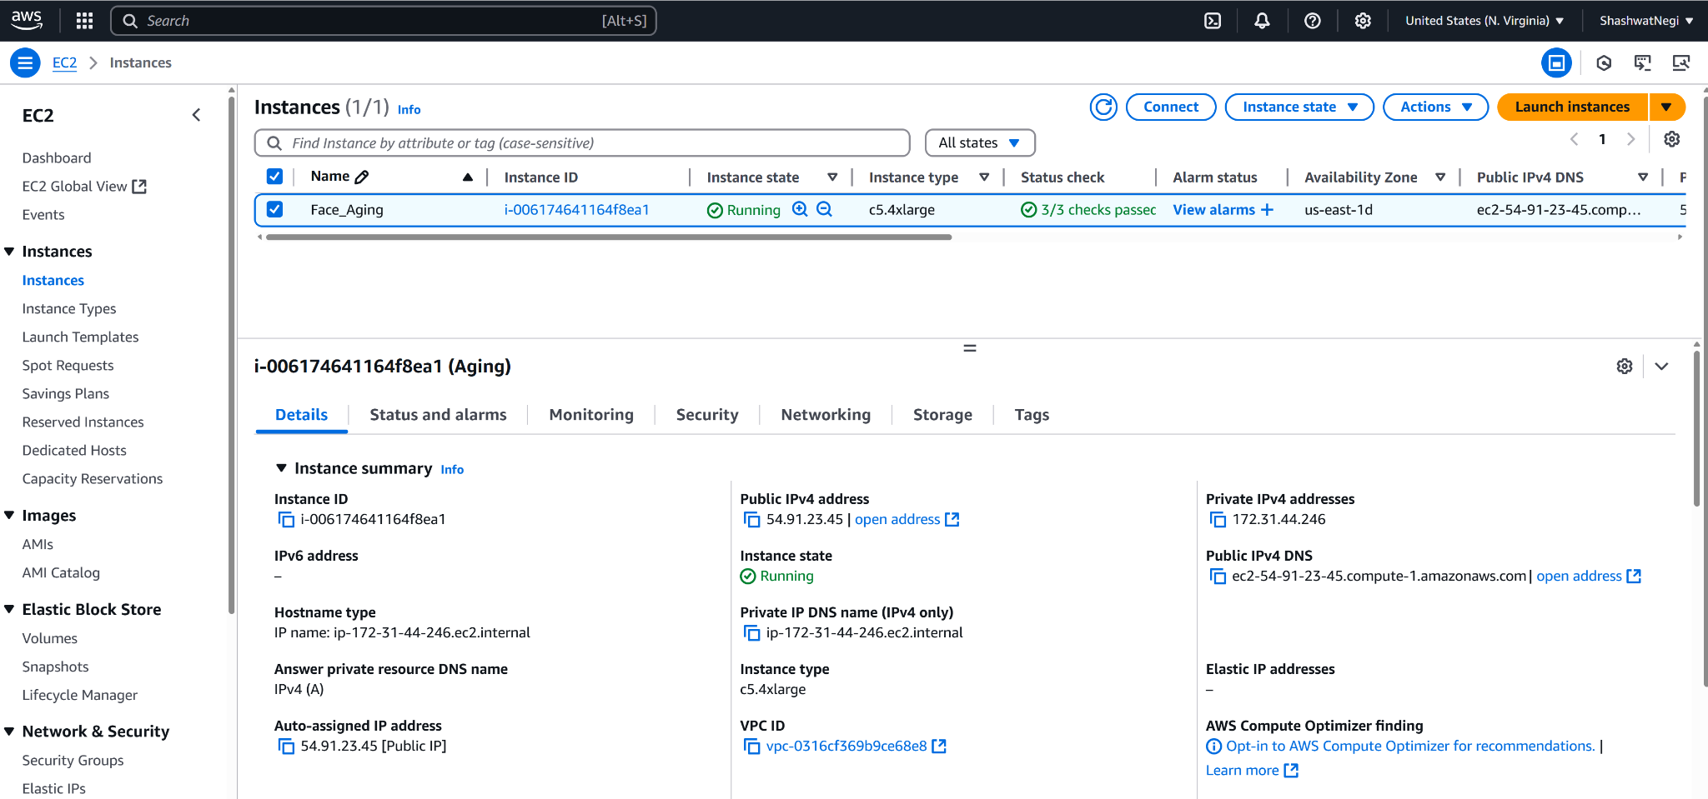
Computational Costs
Both approaches leveraged a pre-trained Stable Diffusion model which contains 850M parameters for task-specific lightweight adaptation. (no-full model fine tuning)
Inference pipeline included noise addition and denoising steps, contributing to higher compute overhead.
Compute Budget: $20
Deployment Specs: AWS c5.9xlarge (32 vCPUs, 72 GB mem) 50 GB SSD
Estimated Cost: ~$25 during inference

Slide 19
Limitations
Limitations of DreamBooth:
Overfitting
No built-in temporal modeling
Limited control
Limitations of Image Inversion:
Lack of aging consistency
Prompt sensitivity
Limited generalization
Notes:
DreamBooth:
As shown by Ian before, the model is somehow overfitting due to the small size of training images
DreamBooth doesn’t learn how a face ages — just learn how to generate the same face in different contexts.
Aging output is prompt-dependent; there's no precise control over the aging direction or level
Image Inversion:
It doesn’t encode "age progression" naturally
Small changes in prompts can lead to inconsistent or unrealistic aging.
Inversion is input-specific. You can’t invert one face and then apply "aging" to a batch of others — no general model is learned.

Slide 20
Future Work
Include HyperNet and LoRa to our comparative study
Measure and compare how each method overfits with limited samples (e.g. DreamBooth vs LoRa)
Apply ControlNet for structural aging
Propose a hybrid method (for example: LoRa + DreamBooth, LoRa + Image Inversion)
Prepare a better interface of the model for user to test
Notes:
3. This will add spatial control, reducing unwanted artifacts and better preserving identity.

Slide 21
References
[1] Goodfellow, Ian, et al. ”Generative adversarial networks.” Communications of the ACM 63.11 (2020): 139- 144.
[2] Ho, Jonathan, Ajay Jain, and Pieter Abbeel. ”Denoising diffusion probabilistic models.” Advances in neural information processing systems 33 (2020): 6840-6851. 2
[3] Grimmer, Marcel, and Christoph Busch. ”AgeDiff: Latent Diffusion-based Face Age Editing with Dual CrossAttention.” 2024 IEEE International Workshop on Information Forensics and Security (WIFS). IEEE, 2024.
[4] Chen, Xiangyi, and St´ephane Lathuili`ere. ”Face aging via diffusion-based editing.” arXiv preprint arXiv:2309.11321 (2023).
[5] Nichol, Alexander Quinn, and Prafulla Dhariwal. ”Improved denoising diffusion probabilistic models.” International conference on machine learning. PMLR, 2021.
[6] Or-El, Roy, et al. ”Lifespan age transformation synthesis.” Computer Vision–ECCV 2020: 16th European Conference, Glasgow, UK, August 23–28, 2020, Proceedings, Part VI 16. Springer International Publishing, 2020.

